Slide 1
Los Angeles County
Dual Enrollment Convening
March 2, 2023

Slide 2
California’s Official College and Career Platform
“All California students deserve the opportunity to earn a college degree and pursue the career of their dreams.
CaliforniaColleges.edu makes it possible for students to plan their career, apply to college, and get financial aid - for free - all on one website.”
— Governor Gavin Newsom

Slide 3
California College Guidance Initiative
Who We Are
State-funded nonprofit.
Manager of CaliforniaColleges.edu.
Phase I operational tools for the Cradle-to-Career system.
Why We’re Here
To smooth the path to college and career for all California students.
To close equity and opportunity gaps.
What We Do
College and career planning tools and curriuclum.
Capacity building.
Provide data-informed tools to fronta line K12 and higher education practitioners.
Visit the Cradle-to-Career Website

Slide 4
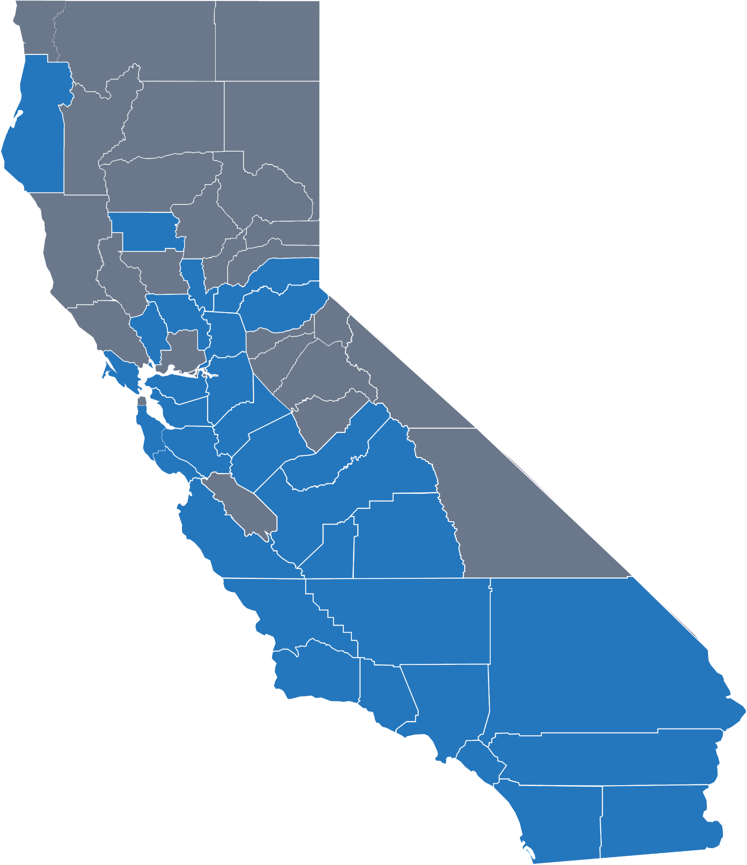
Universal Access to CaliforniaColleges.edu
One goal of the Cradle-to-Career legislation is to make CaliforniaColleges.edu available to every school district, student, and educator in California by 2026.
144 | Official school district partners
1M | 6th-12th grade students served
47 | School districts in the pipeline for partnership by Fall 2023
500K | Additional students in the pipeline who will be served by Fall 2023
Counties with school district partners
Notes:
420 districts that include 9-12th grade students which is where we focus first.

Slide 5
Infrastructure for Districts to Implement Equity-Focused State Policies and Investments
Regional K-16 Education Collaboratives Grant
Universal FAFSA/CADAA (AB 469)
A-G Completion and Improvement Grant

Slide 6
Smoothing the Path for Students
When students are signed in to CaliforniaColleges.edu, educators can track their activities and application progress using built-in reporting tools.
Account Registration
Career Exploration
College & Major Search
Coursework Planning
Financial Aid Lessons
Application Submissions
SUBMIT
Notes:
LA
Contextual Consideration:
Through CaliforniaColleges.edu, we offer a unique comprehensive suite of college, career and financial aid planning information, curricula, and tools that will streamline your school counseling teams ability to support students journey from K-12 to post-secondary institutions.
This is key as school counselors have to leverage this effort despite having large caseloads and shortages on time to meet each and every students college readiness needs. Our tools are a time saver that will equip them to support students’ college readiness journeys efficiently and effectively.
So let’s discuss the process:
First, once a student registers their account, they are able to take their first step in their college readiness journey that initially starts with meaningful career exploration, followed by intentional college and college major search activities, which leads to informed academic planning to promote eligibility and concludes with learning and launching about financial aid , and subsequent also College Application launch.
We want students to discover their college and career goals, make plans for how to achieve them, and launch into fulfilling futures.
Contextual Consideration:
So to reiterate CaliforniaColleges.edu automates time-consuming tasks for counselors and helps them quickly identify and intervene with students who need support and require higher levels of TIer 2 or 3 interventions to become college eligible. The benefit of which can positively impact your College Readiness Indicators as a-g is one of the 8 metrics governing college readiness according to the California Dashboard.
Career Technical Education Pathway Completion
Grade 11 Smarter Balanced Summative Assessments in ELA and mathematics
Advanced Placement Exams
International Baccalaureate Exams
College Credit Course (formerly called Dual Enrollment)
a–g Completion
State Seal of Biliteracy
Military Science/Leadership

Slide 7
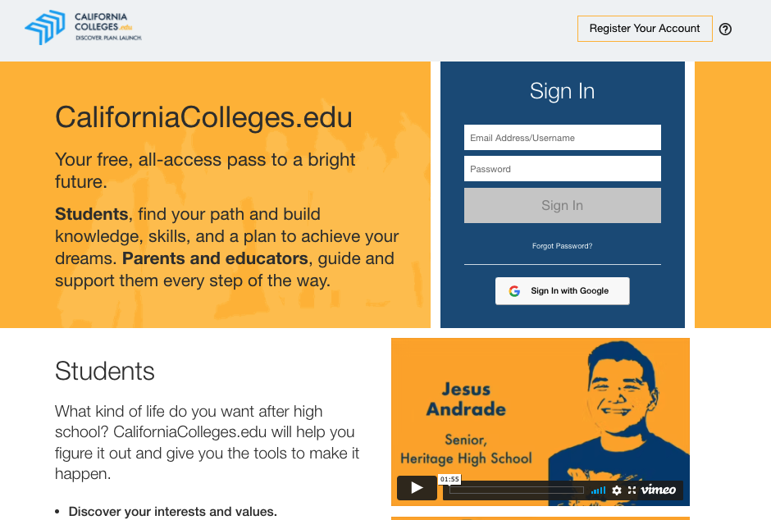
College & Financial Aid Application Integration
Students can launch college and financial aid applications directly from CaliforniaColleges.edu and track their progress.
COLLEGE
FINANCIAL AID

Slide 8
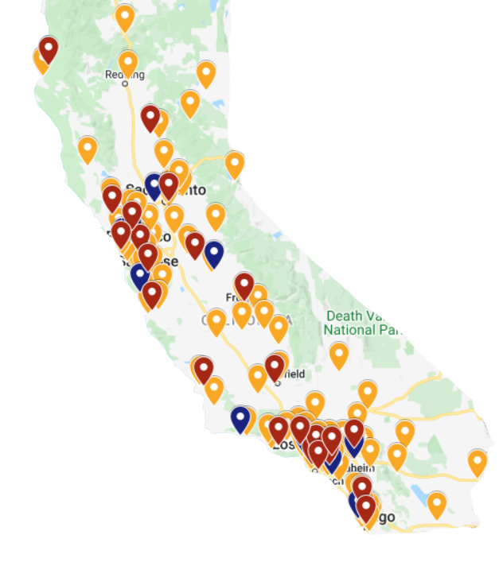
Applications (7/1/21 through 6/30/22)
Institution | Submitted
California Community Colleges PESC Transcripts | 198,622
California State University Cal State Apply Applications | 122,327
University of California UC Applications | 25,161
FAFSA/CA Dream Act Applications | 16,873
California State University
California Community College
University of California
Notes:
NOTE from TCD: These are actually not applications -- they are the number of transcripts sent to CCCCO. I'm using it in place of actual applications launched.
Use tends to correlate to utility or at least the ease of the user experience…
NOTE from LU: I updated the language to specify what type of thing is being submitted, to make space to explain the PESC transcript.

Slide 9
Applications (2021-2022 Academic Year)
Segment | Applications Submitted (7/1/21 through 6/30/22)
California Community Colleges* | 198,622
California State University | 122,327
University of California | 25,161
FAFSA/CADAA | 16,873
Notes:
Use tends to correlate to utility or at least the ease of the user experience…

Slide 10
Cal State Apply Course Migration Demo

Slide 11
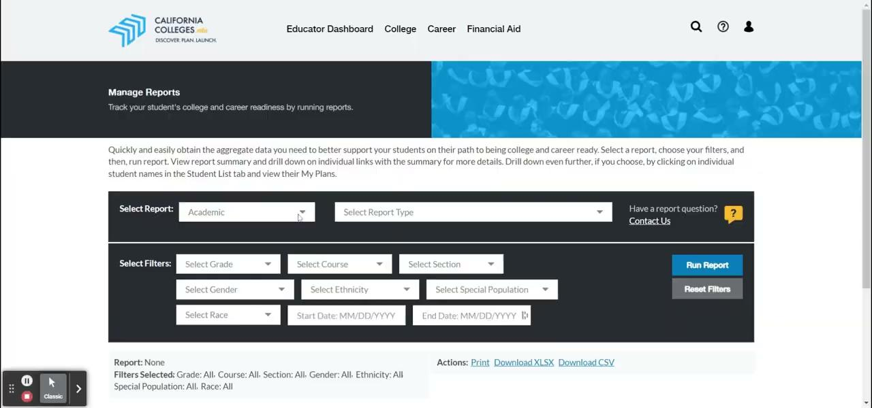
Cal State Apply Course Migration Demo
Educators in partner districts can run reports to monitor student progress on their activities on CaliforniaColleges.edu.

Slide 12
Dual Enrollment

Slide 13
Credit Where Credit is Due
Goal: Ensure students’ dual enrollment coursework informs their understanding of their eligibility and can easily be submitted as part of college applications.
Step 1 | Connect SSID to CCCID with clear flag of a student’s special admit status (both CCAP and independently pursued).
Step 2 | Integrate K-12 identified dual enrollment courses into CSU and UC Eligibility Tools on CaliforniaColleges.edu.
Step 3 | Integrate verified dual enrollment courses into seamless application processes with the CCC, CSU, and UC systems.

Slide 14
Questions?

